Slide 1

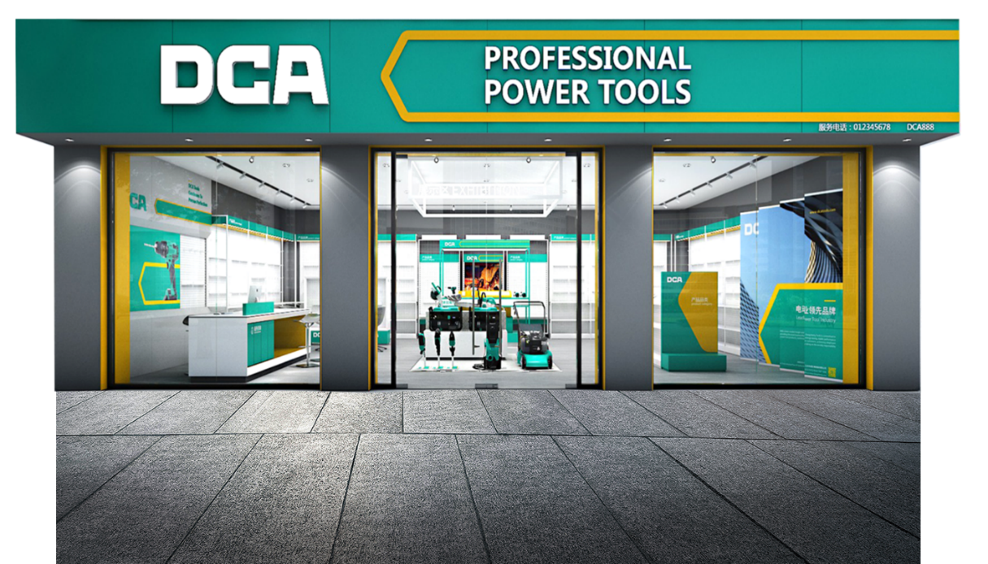
2024
EBS/EIBC
CONSTRUCTION GUIDE MANUAL

Slide 2

DCA Logo Change Statement
Dear customers and partners
Thank you for your continuous love and support for the DCA brand. For further development, the current DCA Logo has been upgraded, and the company will gradually replace it with the new one.

Slide 3



01
SHOP OWNER MANUAL
02
SUPPORT POLICY
CONTENTS
03
STANDARD PROCESS
04
APPLICATION& EXAMINATION FORMS

Slide 4
SHOP OWNER MANUAL
01
EBS/EIBC DESIGN SKETCH
02
THE BENEFITS OF EIBC SHOP OWNER
PART 01
03
EIBC TYPE
04
STOREFRONT SIGNBOARD STANDARD
05
REGISTRATION STANDARD OF EIBC

Slide 5
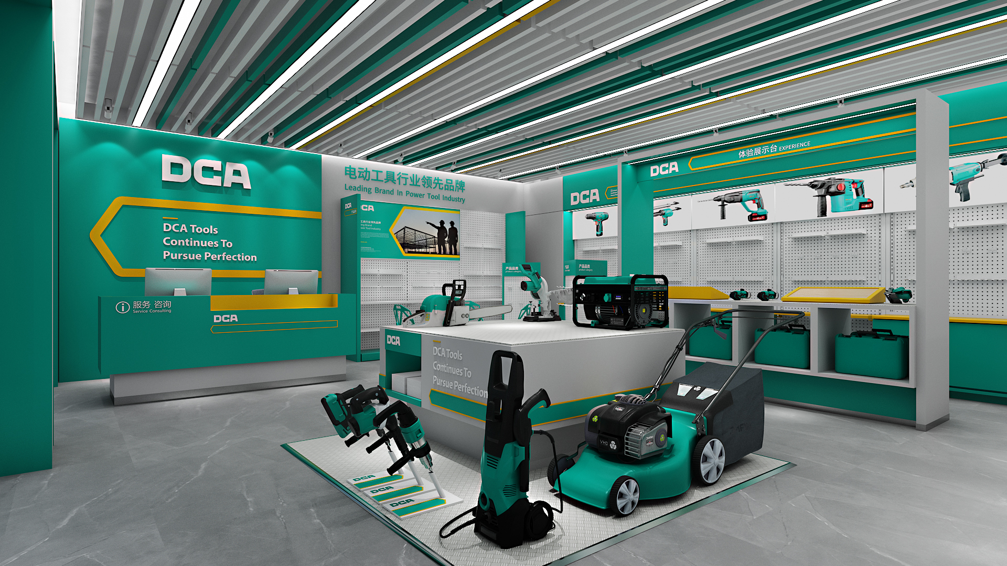
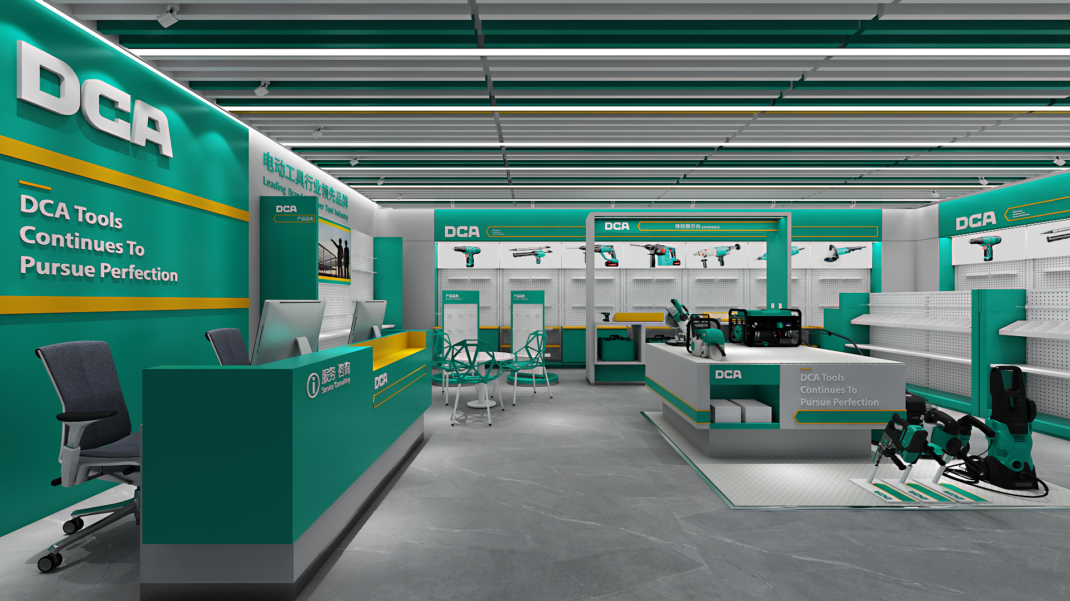
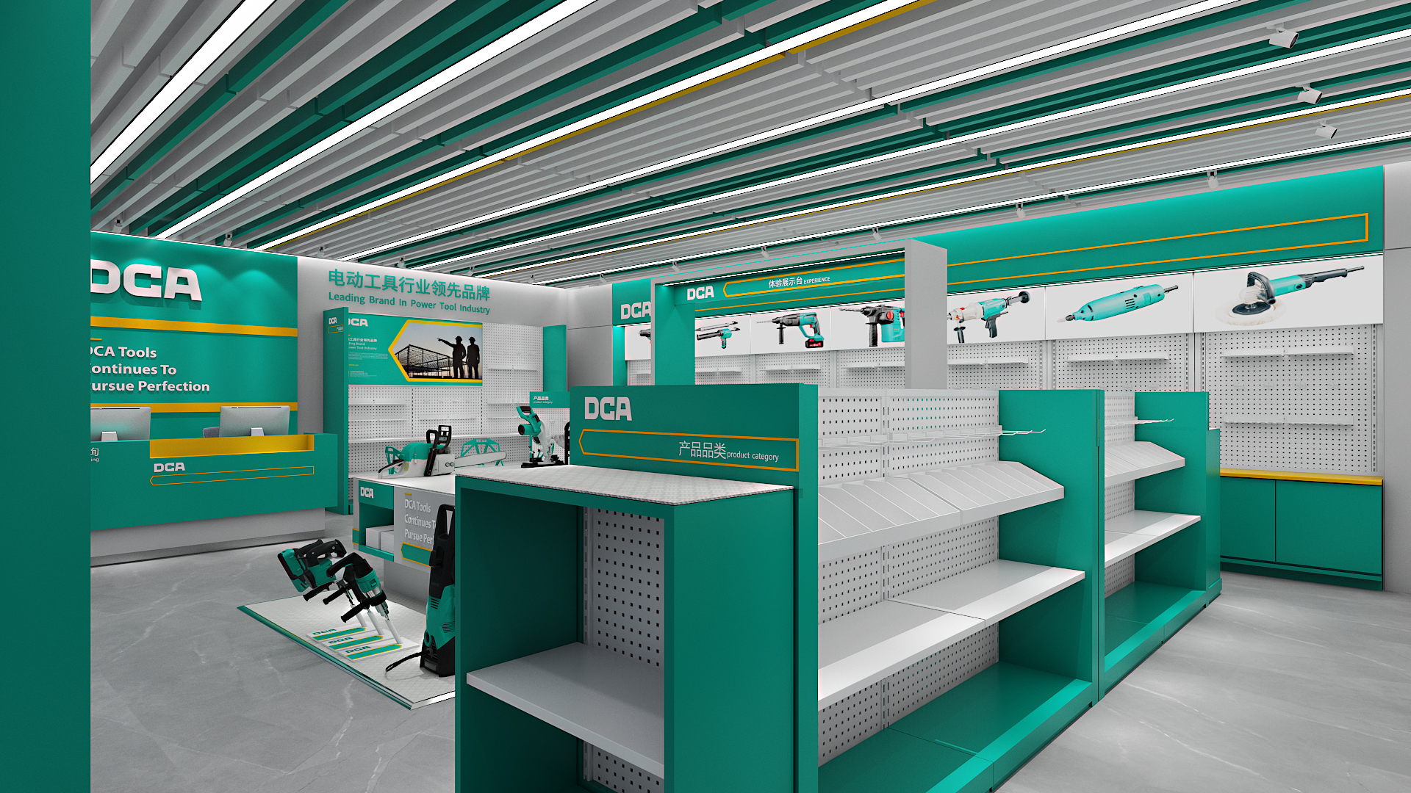
01-1
EBS DESIGN SKETCH
Dongcheng Company would like to offer 100$/m² maximum decoration support for EBS, you can contact your business Manager for details if you are interested in it.

Slide 6
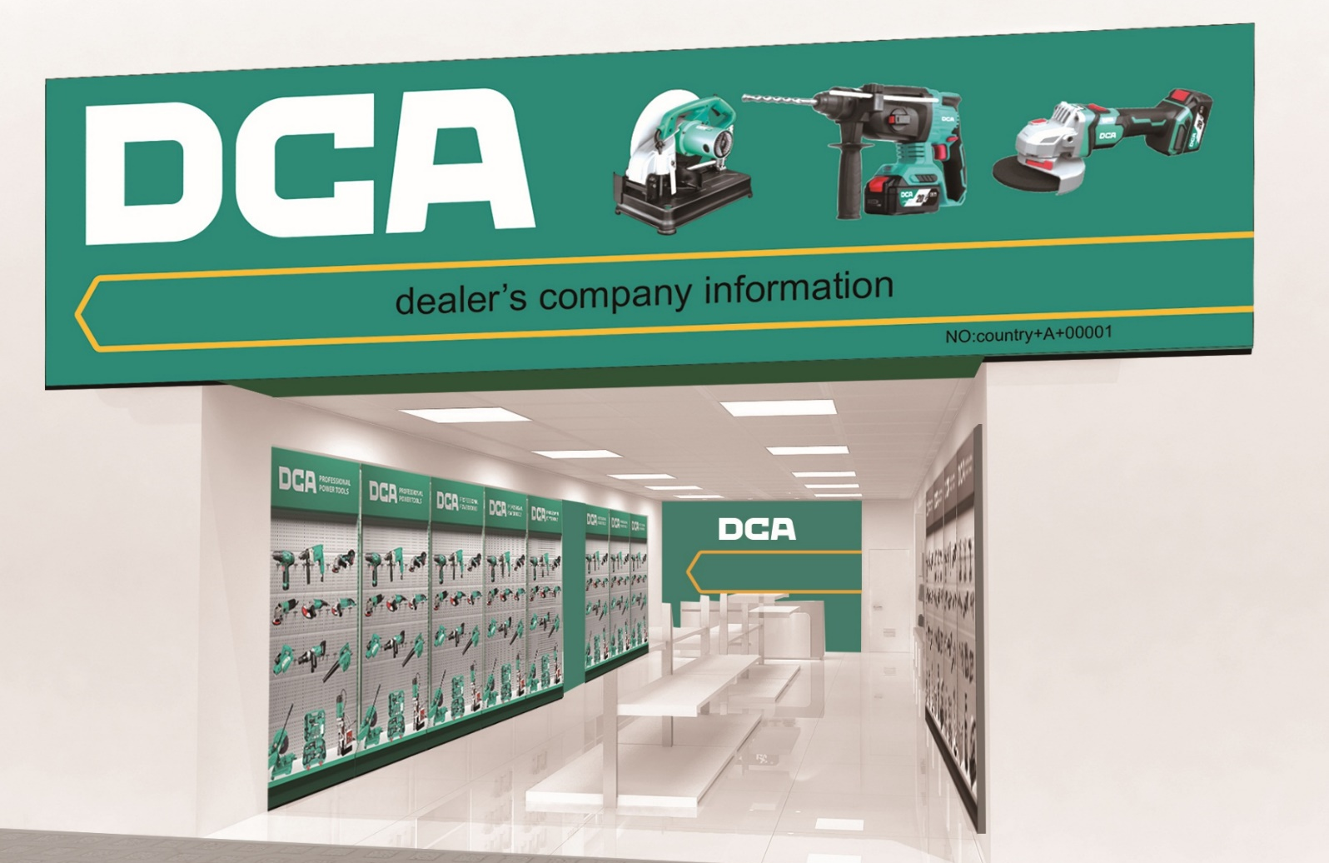

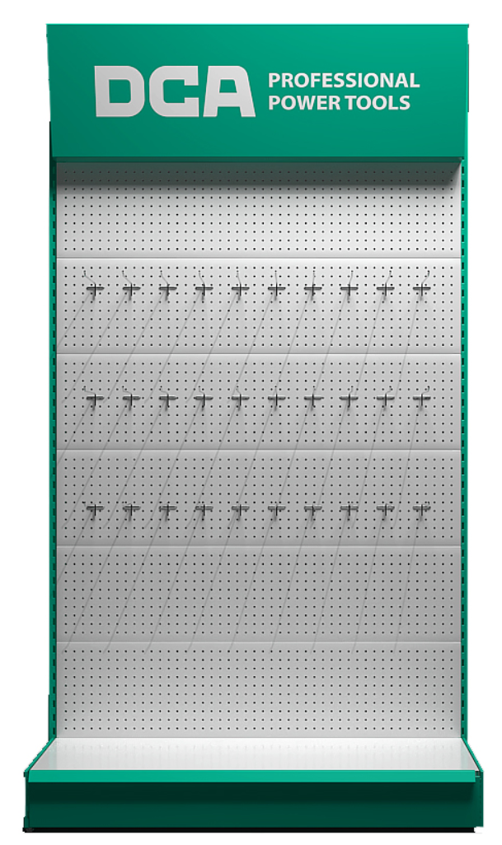
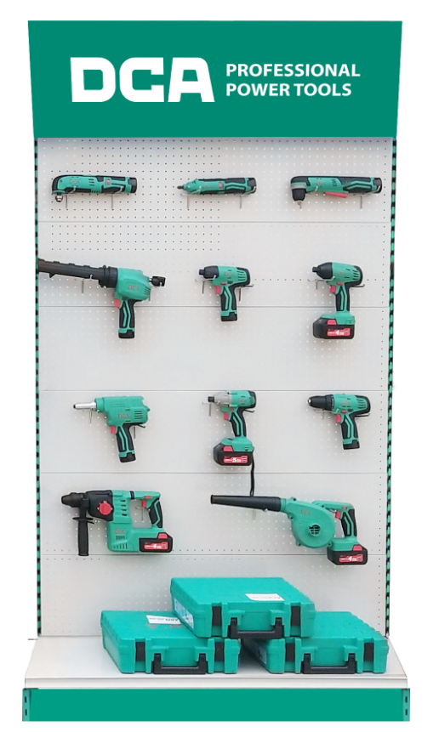
01-1
EIBC DESIGN SKETCH
Storefront Signboard
Display Stand
Products

Slide 7
01-1
EIBC DESIGN SKETCH
Without Signboard
S type : AS BS CS ES
Storefront Signboard
Display Stand
Products

Slide 8








01-2
THE BENEFITS OF EIBC SHOP OWNER
SHOP IMAGE UPGRADE
SALES SPONSOR
Free Display Stands & Decoration Plan
Signboard & Variety promotion items support
Increase the rate of entering the store, and the rate of transaction
Visiting on Schedule
Marketing Activities Plan
EXCLUSIVE PROMOTION
FOC DISPLAY TOOLS
Exclusive Promotion in Selected Models
Get the free Display Machines ever year
TECHNICAL TRAINING
NEW PRODUCTS PRIORITY
Free technical training from Dongcheng College
New Products Launching Priority
The rights to join the Experience and Test plan of New products

Slide 9








01-2
THE BENEFITS OF EIBC SHOP OWNER
Free Display Machine Support ( Every Year)
Maintenance Support
( Every Year)
Construction Support
( Only In The First Year)
Service Support
( According to The Market Needs)
Up to $100/㎡ subsidy
AA
$ 2800 FOC Tools/year
$ 1000/year Signboard Support
$1000 Decoration Support
A
$ 800 FOC Tools/year
$400/year Signboard Support
$400 Decoration Support
B
$500 FOC Tools/year
$300/year Signboard Support
$300 Decoration Support
C
$380 FOC Tools/year
$200/year Signboard Support
$200 Decoration Support
E
$250 FOC Tools/year
$200/year Signboard Support
$200 Decoration Support
F
$100 FOC Tools/year
$200/year Signboard Support
$200 Decoration Support
Type S is without storefront signboards; Type F applies to only some specific markets.

Slide 10
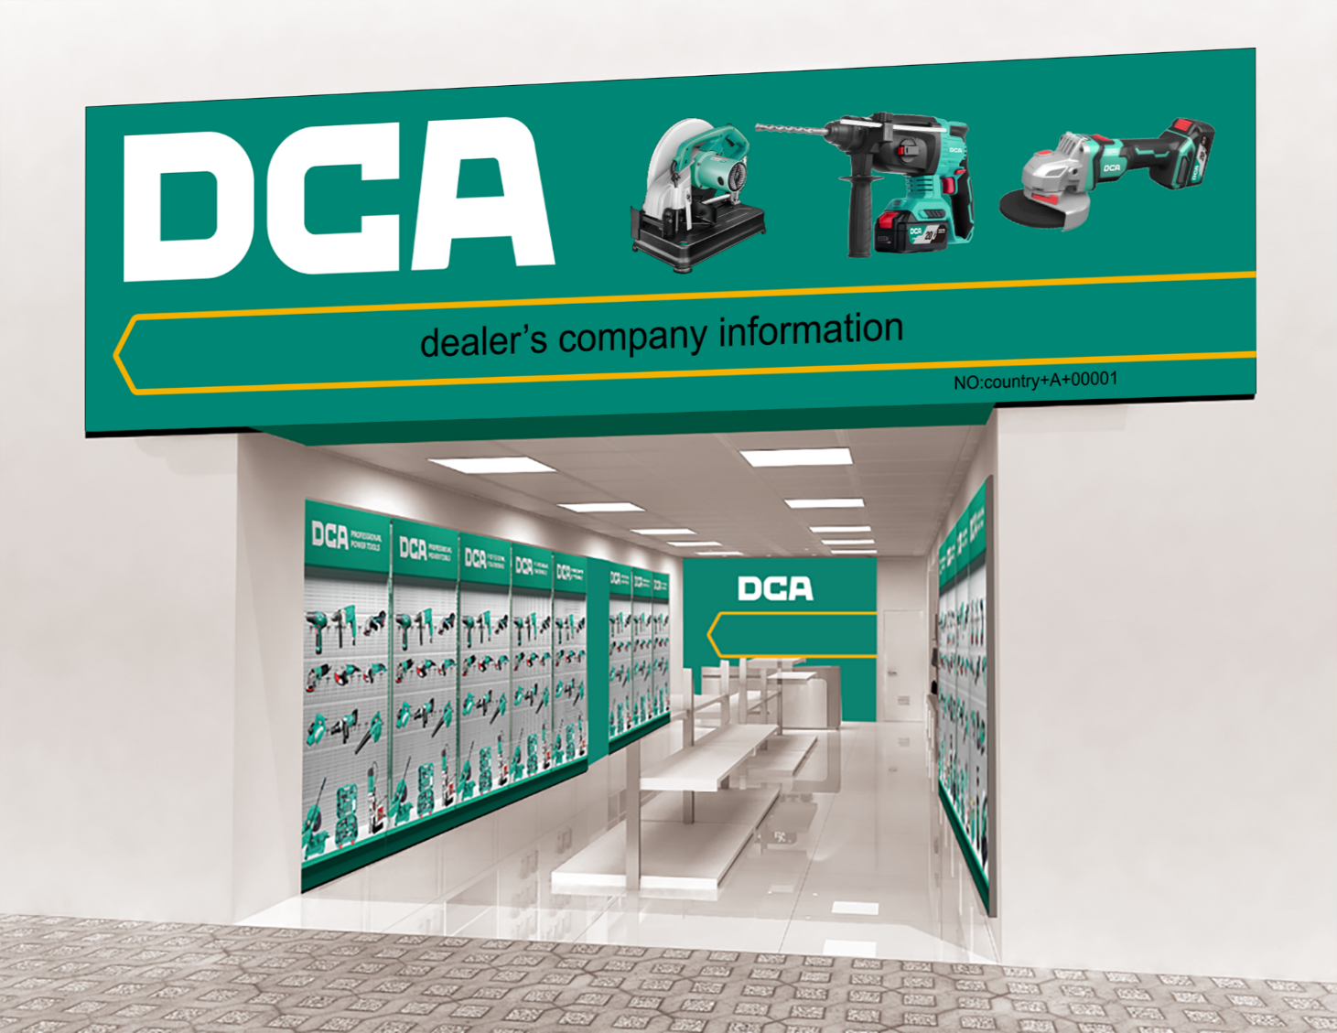
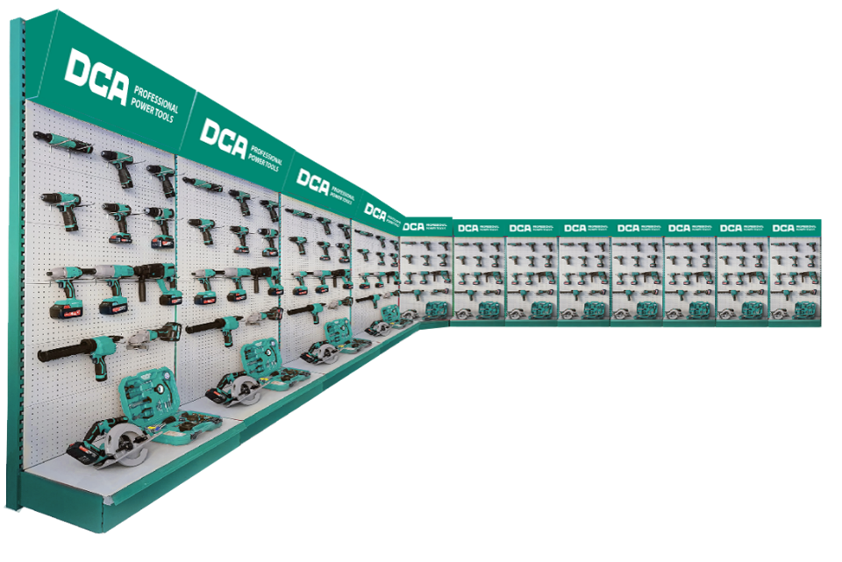
01-3
TYPE AA EIBC
AA
12pcs display stands with over 80 items

Slide 11
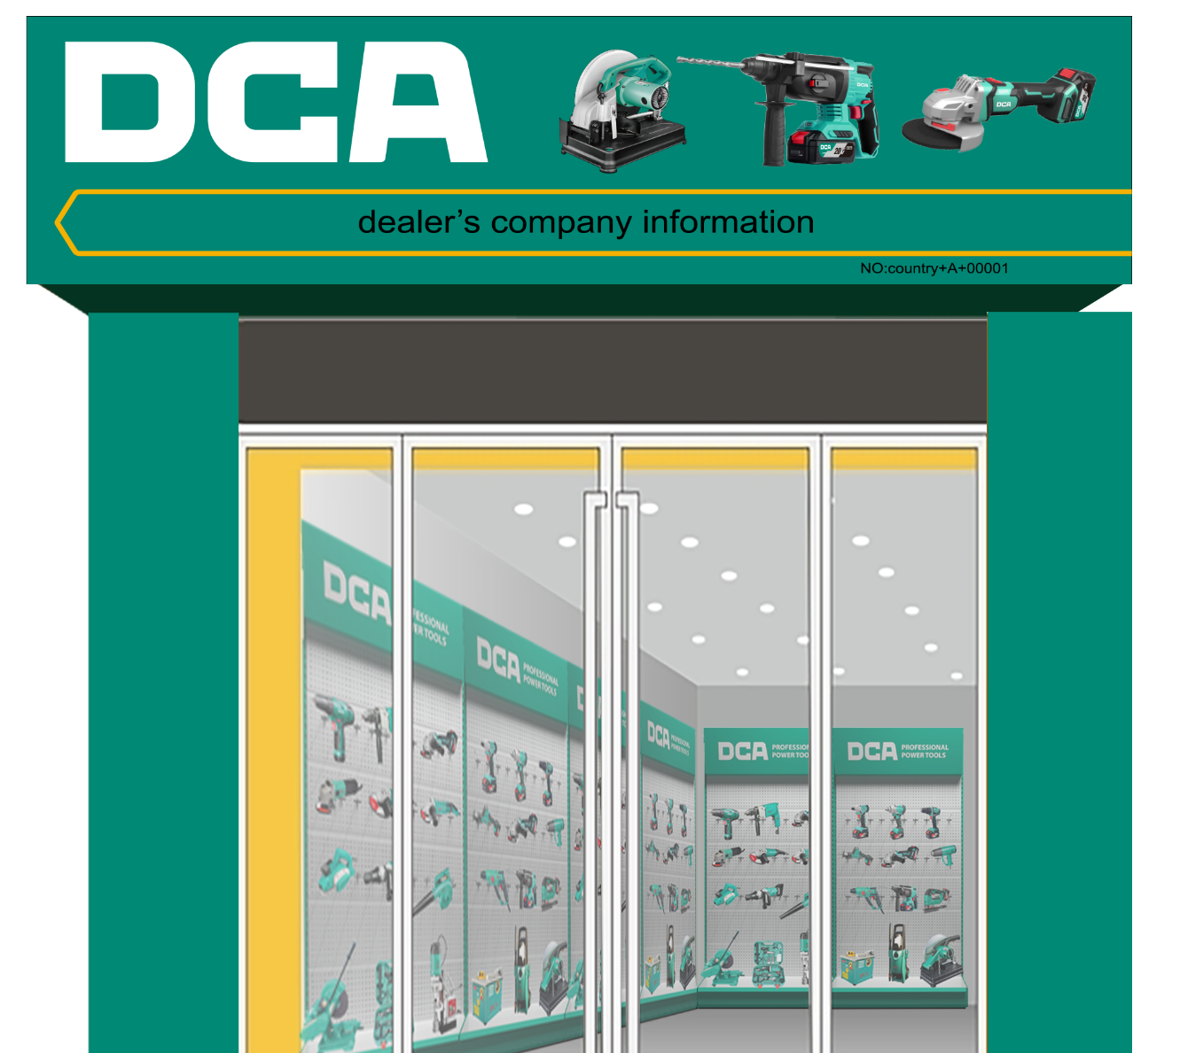
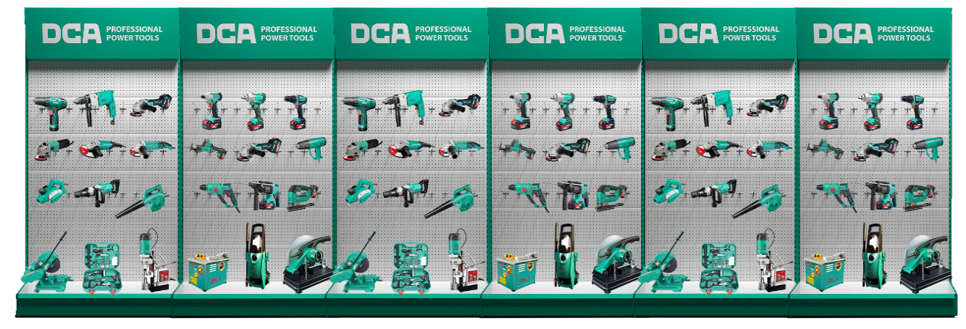
01-3
TYPE A/AS EIBC
A/AS
6pcs display stands with over 50 items
Type S is without storefront signboards.

Slide 12
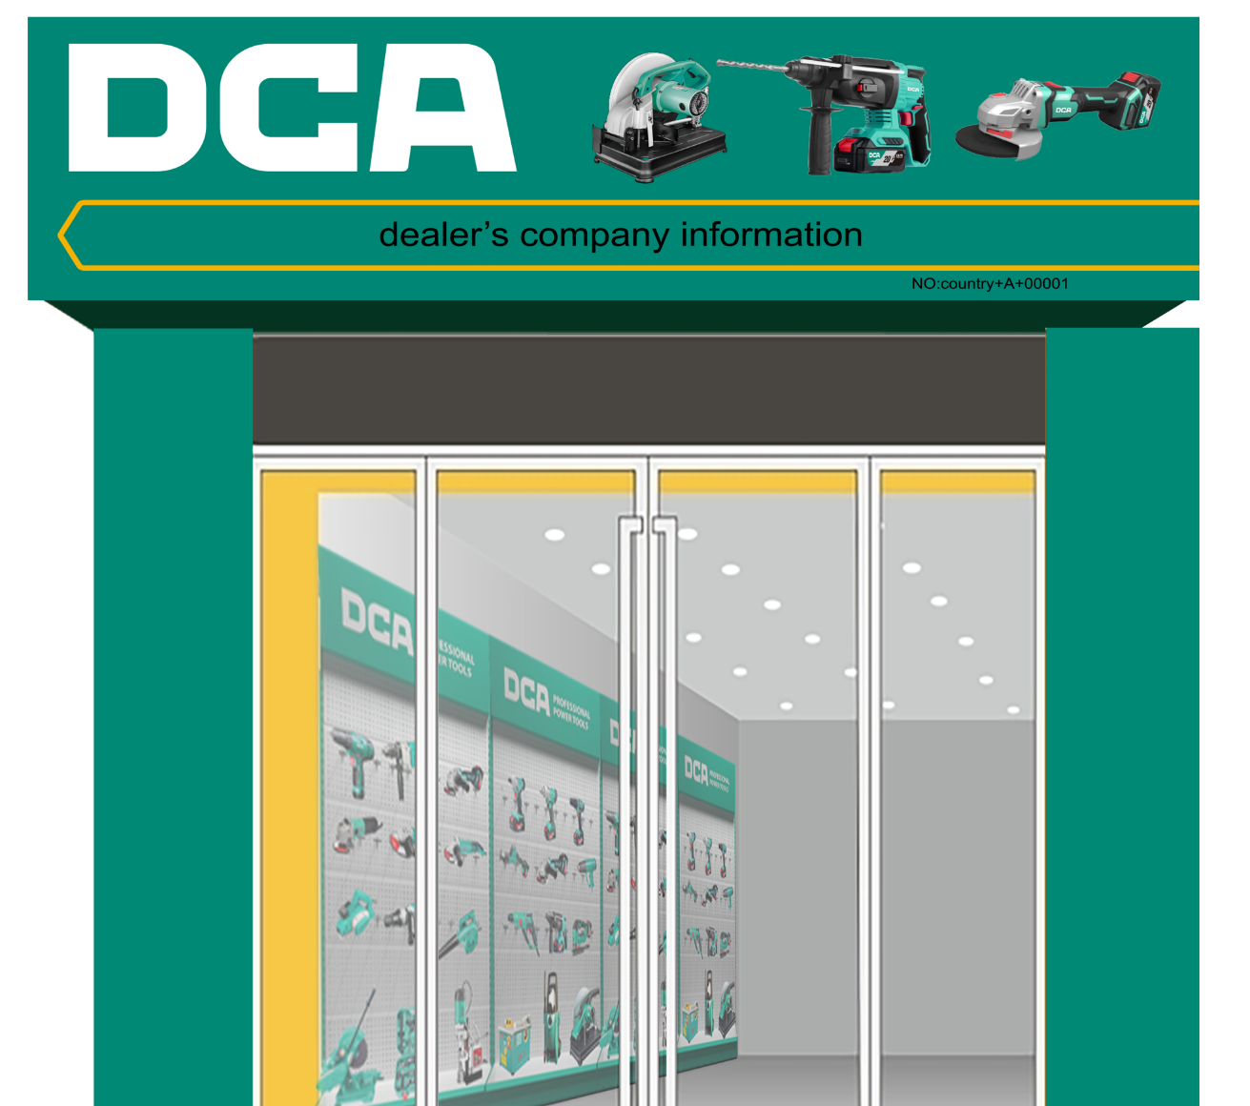
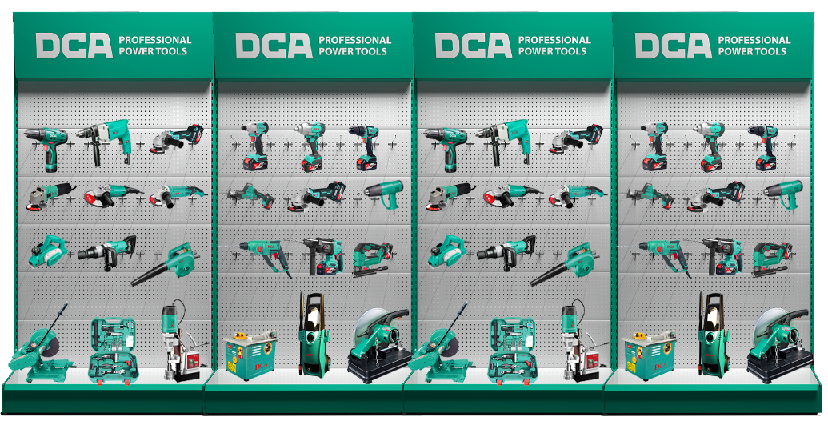
01-3
TYPE B/BS EIBC
A
B/BS
4pcs display stands with over 30 items
Type S is without storefront signboards.

Slide 13
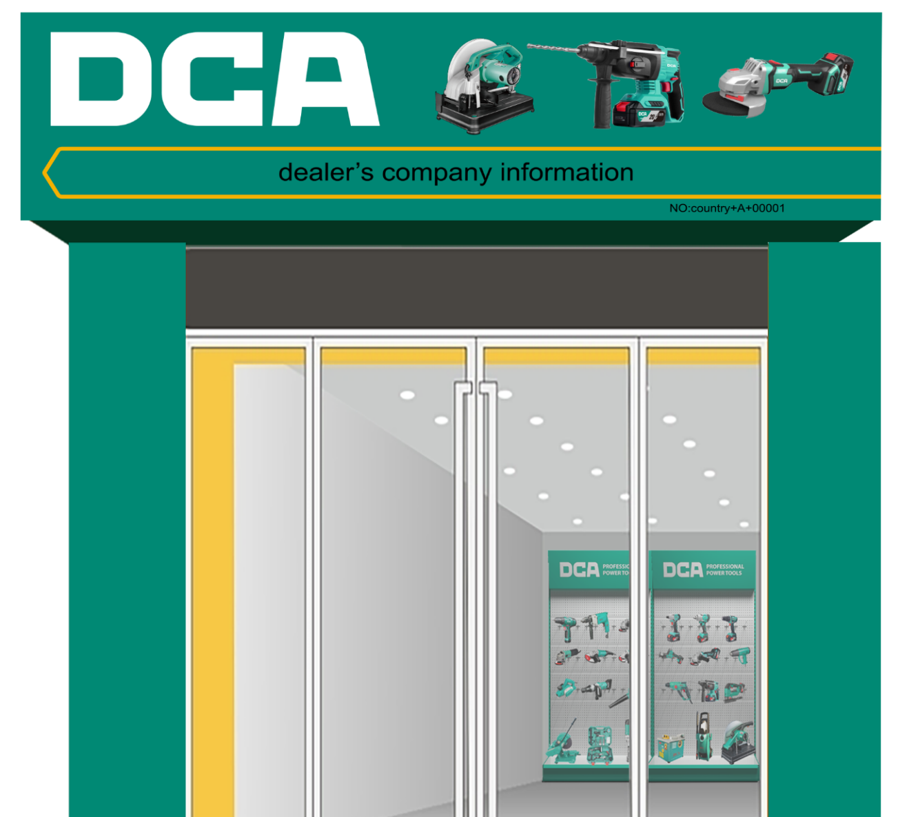
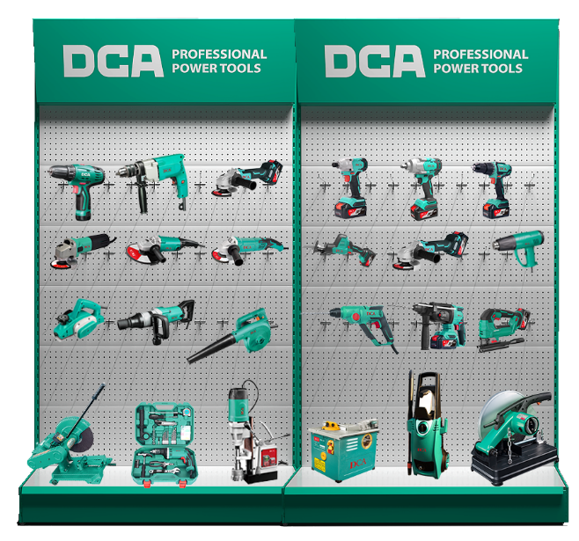
01-3
TYPE C/CS EIBC
C/CS
2pcs display stands with over 20 items
Type S is without storefront signboards.

Slide 14
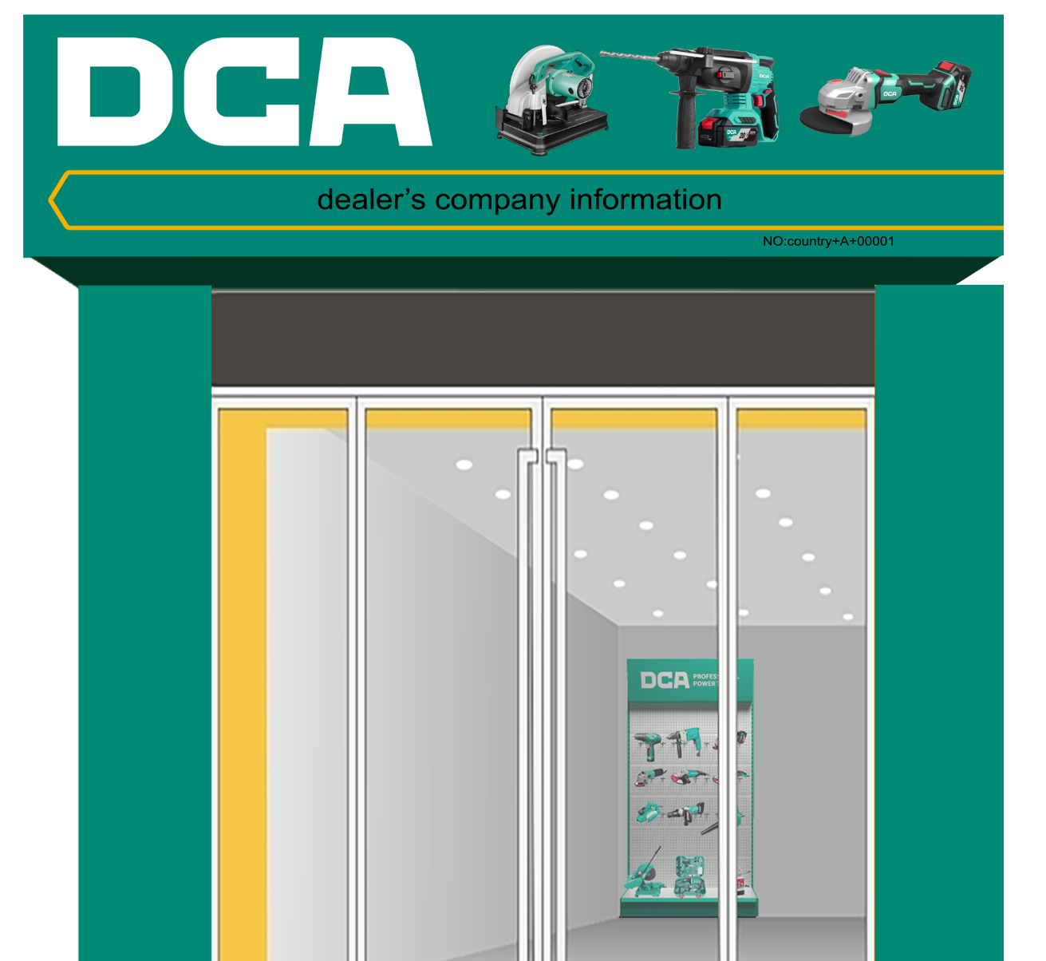
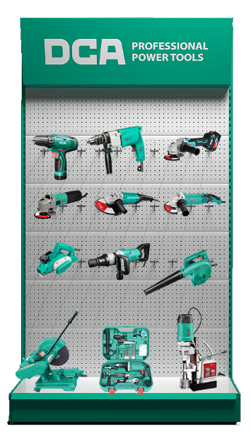
01-3
TYPE E/ES EIBC
E/ES
1pc display stands with over 10 items
Type S is without storefront signboards.

Slide 15
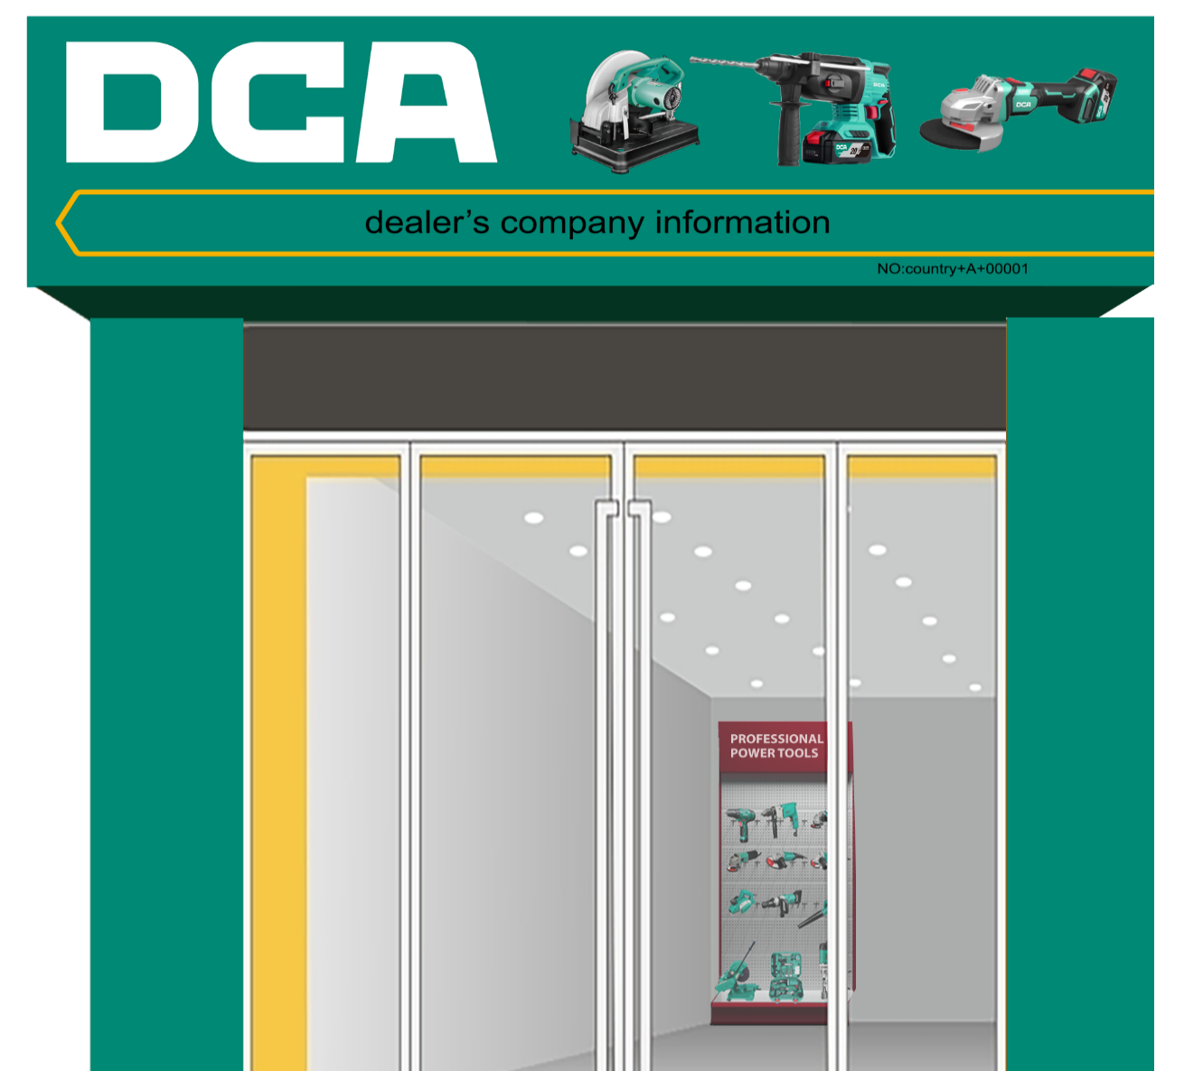
01-3
TYPE F EIBC
F
With over 10 items
Type F applies to only some specific markets.

Slide 16

01-4
Storefront Signboard Standard
DCA Logo
Product Photos
Shop Name
Shop Contacts &
Series Number
S

Slide 17
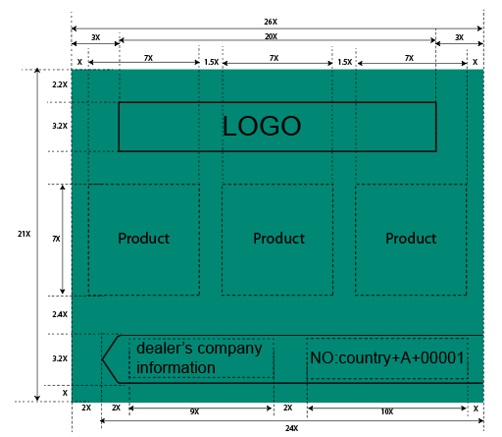
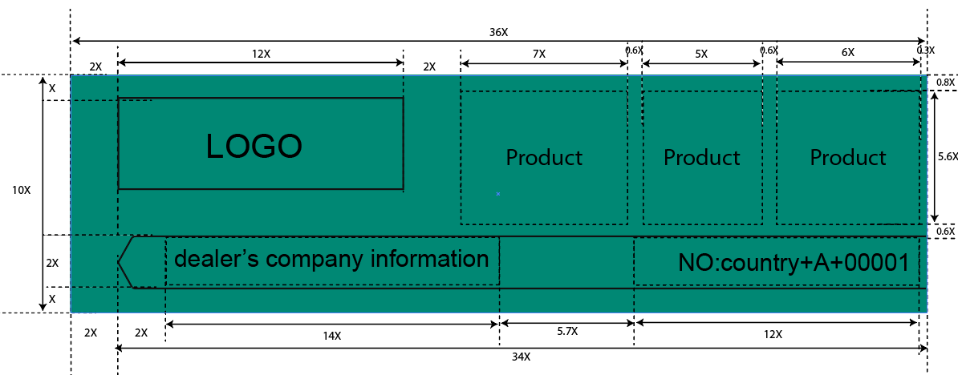


01-4
Storefront Signboard Standard
01
02
A/AS
A

Slide 18
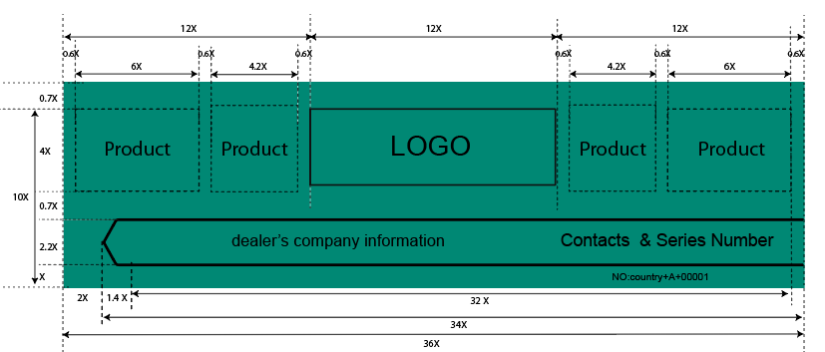
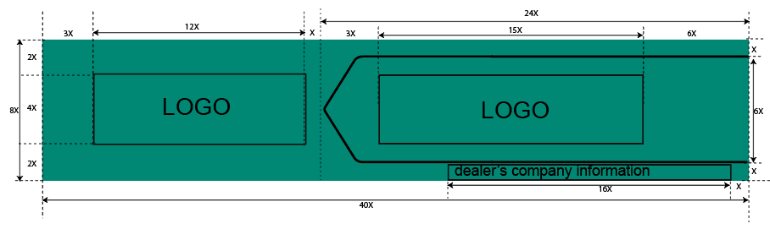
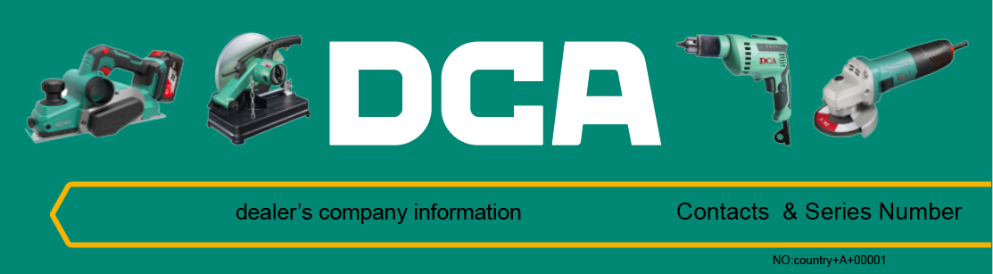

01-4
Storefront Signboard Standard
03
04
A/AS

Slide 19
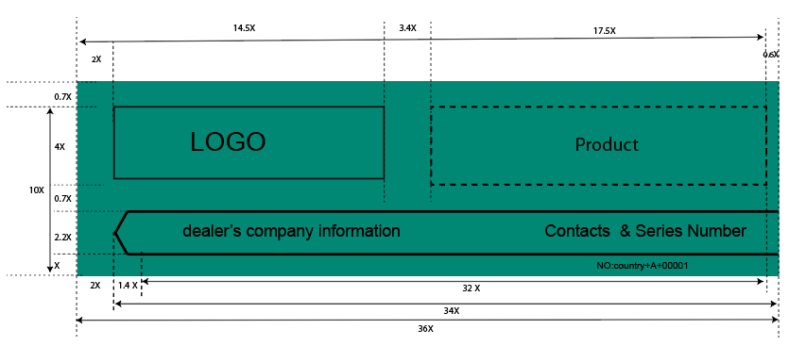
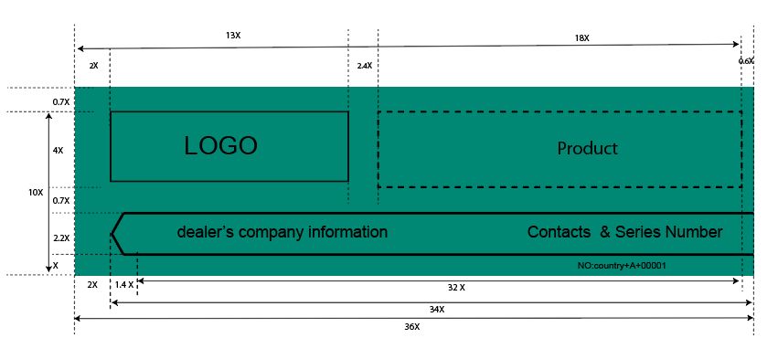

01-4
Storefront Signboard Standard
05
06
A/AS
A

Slide 20


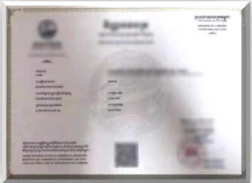
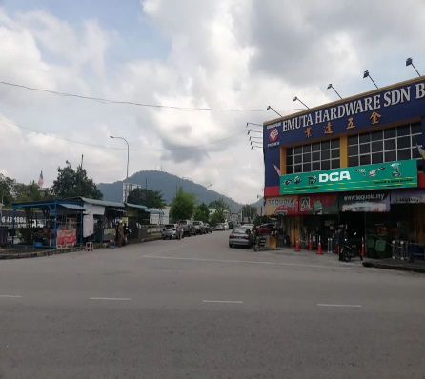
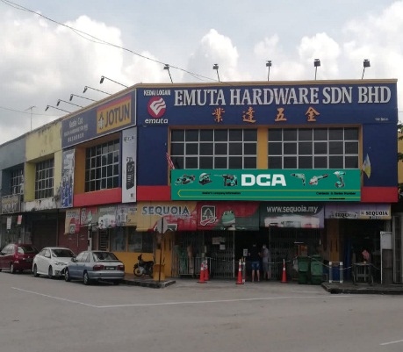
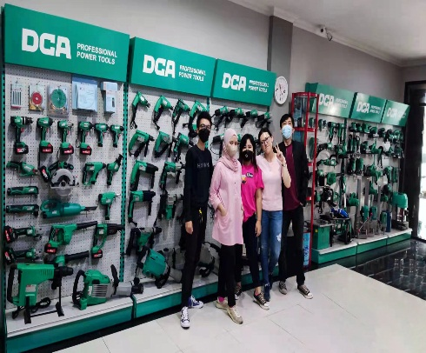
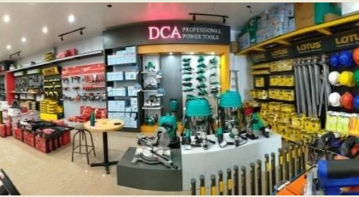
01-5
Registration Standard of EIBC - SAMPLE PHOTOS
Street
View
Photo
Storefront
Signboard
Photo
Stand
Displaying
Photo
Store
Overview
Photo
Business
License

Slide 21
01-5
Registration Standard of EIBC - CHECK LIST
Check list
Business License: | A business license must be provided
Street View: | It has to be a real store, not a warehouse.
Storefront Signboard: | The size and content meet the company’s standard, no obvious fading, no stain, no loosening, and is well installed. Shop series number should be shown on the storefront signboard.
Display Stand: | Clean and free of stains, no obvious discoloration, and no other brand products are displayed on the shelves.
Machine Displaying: | Meet the display Standards of EIBC, the machines are clean, free of dust and oil.
Light Box Ads (Optional) : | There is no obvious fading, and no contamination. The light box is firmly installed and works normally.
In-store Ads (Optional) : | The Ads meet the Dongcheng Company's VI Standards, no obvious fading, no stain, no loose, and it is installed well.
In-store Poster (Optional) : | Posted in the most visible location in the store, without defacement and without expiration.

Slide 22
PART 02
SUPPORT POLICY

Slide 23
02
SUPPORT POLICY
Overseas Exclusive Brand Store & Exclusive In-store Brand Corner Policy
Project Type |  |  | Exclusive Brand Store（EBS） | Exclusive In-store Brand Corner (EIBC) |  |  |  |  | Special EIBC | Form of the support
Store Level |  |  |  | AA | A/AS | B/BS | C/CS | E/ES | F
Construction Conditions |  | Storefront Signboard | With qualified storefront signboard | With qualified storefront signboard | A: With qualified storefront signboard AS: Without storefront signboard | B: With qualified storefront signboard BS: Without storefront signboard | C: With qualified storefront signboard CS: Without storefront signboard | E: With qualified storefront signboard ES: Without storefront signboard | With qualified storefront signboard | /
 |  | Display Stand | Store size ≥ 30m² | 12pcs display stands (Store size ≥ 30m²) | 6pcs display stands | 4pcs display stands | 2pcs display stands | 1pc display stand | ≥1 Existing shelves/racks
 |  | Displaying Samples | Power tools (≥80 different items), Hand tools, Accessories | Power tools (≥80 different items), Hand tools, Accessories | Power tools (≥50 different items), Hand tools | Power tools (≥30 different items), Hand tools | Power tools (≥20 different items) | Power tools (≥10 different items) | Power tools (≥10 different items)
1 | Decoration Support | Decoration | Up to $100/m² | $1000 | $400 | $300 | $200 | $200 | $200 | Payment deduction after store is registered, only in the first year
 |  |  | (Store uniform decoration, signboard) | (Storefront signboard) | (Storefront signboard) | (Storefront signboard) | (Storefront signboard) | (Storefront signboard) | (Storefront signboard)
2 | Maintenance Support | Signboard Support | Contact your business Manager for details | FOC Display Tools valued | FOC Display Tools valued | FOC Display Tools valued | FOC Display Tools valued | FOC Display Tools valued | FOC Display Tools valued | In the form of FOC Display Tools, every year for qualified EIBC
 |  |  |  | $1000 per year | $400 per year | $300 per year | $200 per year | $200 per year | $200 per year
 |  | Qualified Displaying Support | Contact your business Manager for details | FOC Display Tools valued | FOC Display Tools valued | FOC Display Tools valued | FOC Display Tools valued | FOC Display Tools valued | FOC Display Tools valued
 |  |  |  | $2800 per year | $800 per year | $500 per year | $380 per year | $250 per year | $100 per year
 | Notes: | 1. Shop owner with annual purchasing value more than US $100,000 will get the rights to apply for construction of EBS.

Slide 24
STANDARD PROCESS
01
EIBC CONSRTUCTION PROCESS
PART 03
02
SUPPORT DISTRIBUTION PROCESS - EIBC CONSRTUCTION
03
EIBC ANNUAL EXAMINATION PROCESS
04
SUPPORT DISTRIBUTION PROCESS - EIBC ANNUAL EXAMINATION

Slide 25
03-1
EIBC CONSRTUCTION PROCESS
Apply
Shop owner submit the EIBC building application to distributor
Get EIBC Material
Distributor send stands, free samples and signboard to shop owner to build EIBC if agreed
Register
Distributor register the EIBC in Dongcheng Company
No
Modify
Yes
Fulfill
Yes
Qualified
The distributor need to discuss and confirm the EIBC FOC product list with Dongcheng Company before building the EIBC.
A/AS
A
B/BS
Shop owner should provide 4 photos including Storefront Signboard photo, Street View photo, Store Overview photo, and Stand Displaying photo,
and business license when registering the EIBC.

Slide 26
03-2
SUPPORT DISTRIBUTION PROCESS - EIBC CONSRTUCTION
Submit The Receipt
Shop owner sign the receipt
,when the distributor register the EIBC successfully
Deliver Support
Dongcheng Company fulfill the support and send the free Samples to the distributor
Fulfill
/AS
A
B/BS

Slide 27
03-3
EIBC ANNUAL EXAMINATION PROCESS
Annual
Examination
Shop owner should provide the maintenance material(4 photos ) one year after Registering.
Qualified
Check
Yes
Modify
No
Cancel
Shop owner should provide 4 photos including Storefront Signboard photo, Street View photo, Store Overview photo, and Stand Displaying photo, to recheck after one year maintenance.
The distributor needs to confirm the EIBC FOC products list with Dongcheng Company before the Annual Examination.
Dongcheng Company has rights to stop giving the support if the modification delays more than 6 months.
A/AS
A
B/BS

Slide 28
03-4
SUPPORT DISTRIBUTION PROCESS - EIBC ANNUAL EXAMINATION
Deliver Support
Dongcheng Company will fulfill the support and send the FOC EIBC machines to the distributor after the EIBC annual examination process
Get Support
The distributor send the FOC EIBC machicnes to shop owner
Submit The Receipt
Shop owner sign the receipt
The distributor needs to provide the list receipt signed by the shop owner within 2 months after the fee is issued.
A/AS
A
B/BS

Slide 29
APPLICATION & EXAMINATION FORMS
01
EIBC APPLICTION FORM
PART 04
02
PHOTO REQUIREMENTS
03
SHOP OWNER’S RECEIPT
04
ANNUAL EXAMINATION TASK CARD

Slide 30
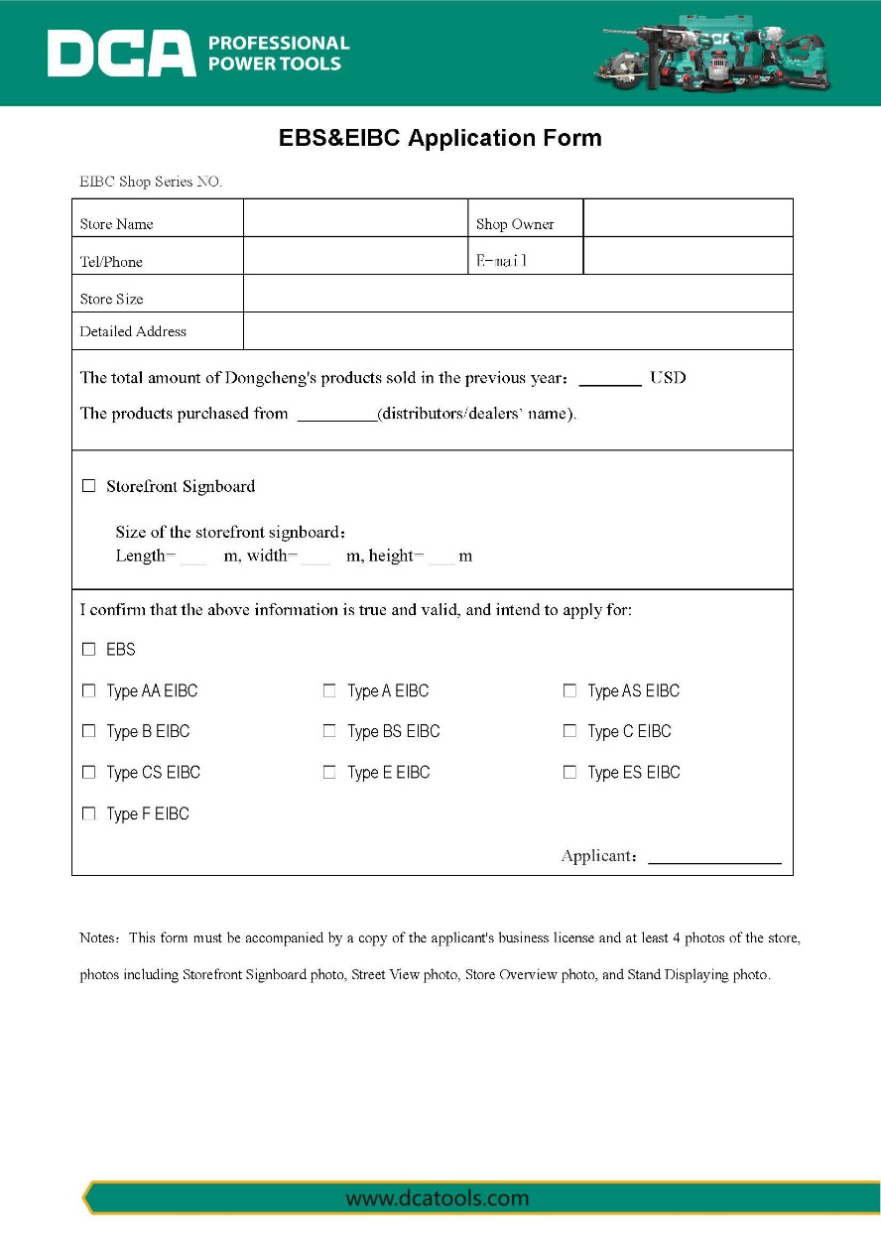
04-1
APPLICATION FORMS - EIBC APPLICTION FORM
Notes:see the attachment for detail

Slide 31
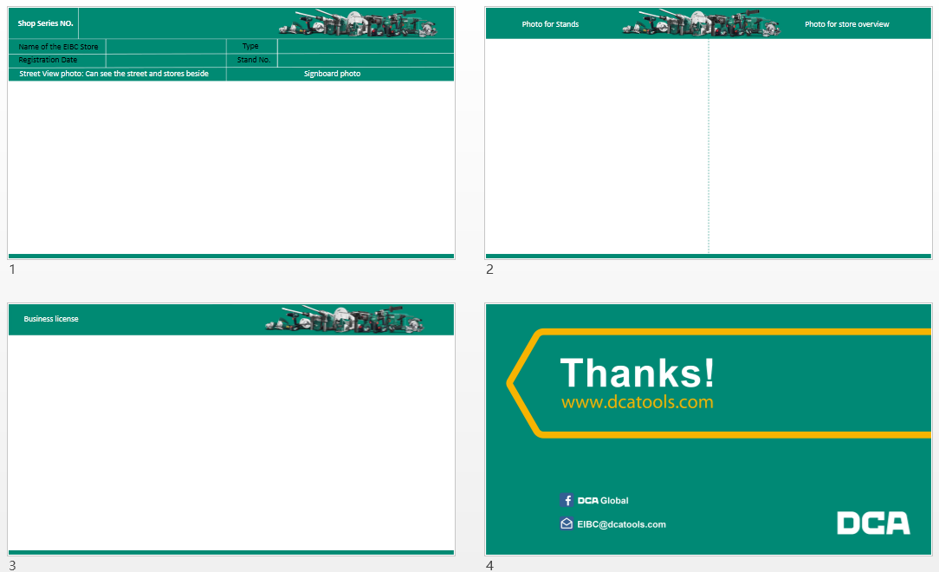
04-2
APPLICATION FORMS - PHOTO REQUIREMENTS
Notes:see the attachment for detail

Slide 32
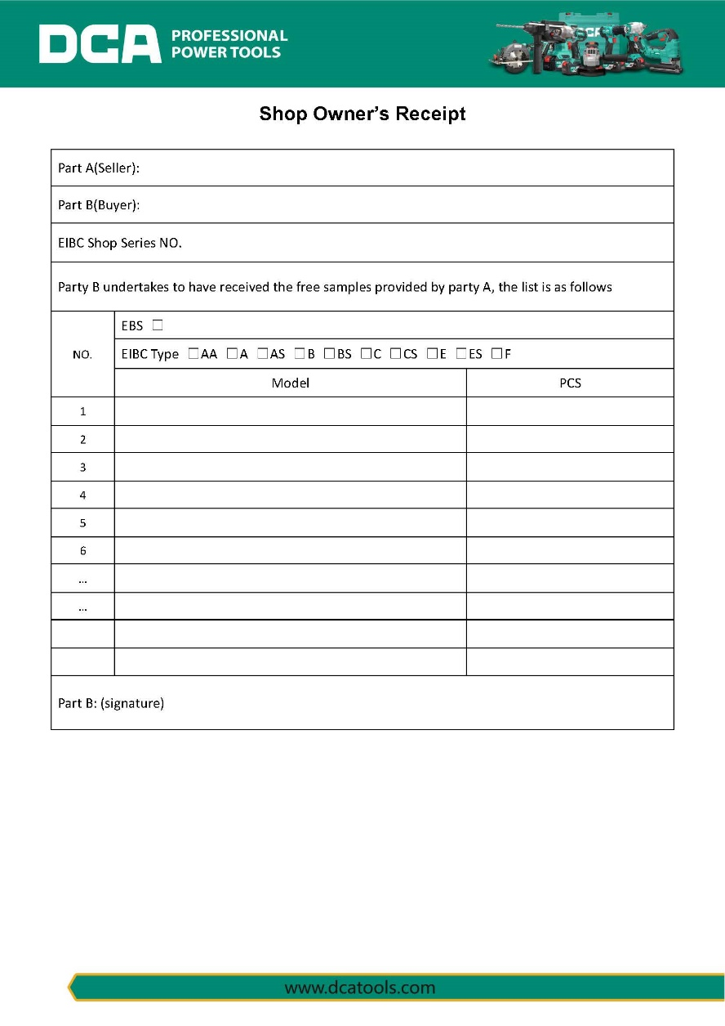
04-3
APPLICATION FORMS - SHOP OWNER’S RECEIPT
Notes:see the attachment for detail

Slide 33
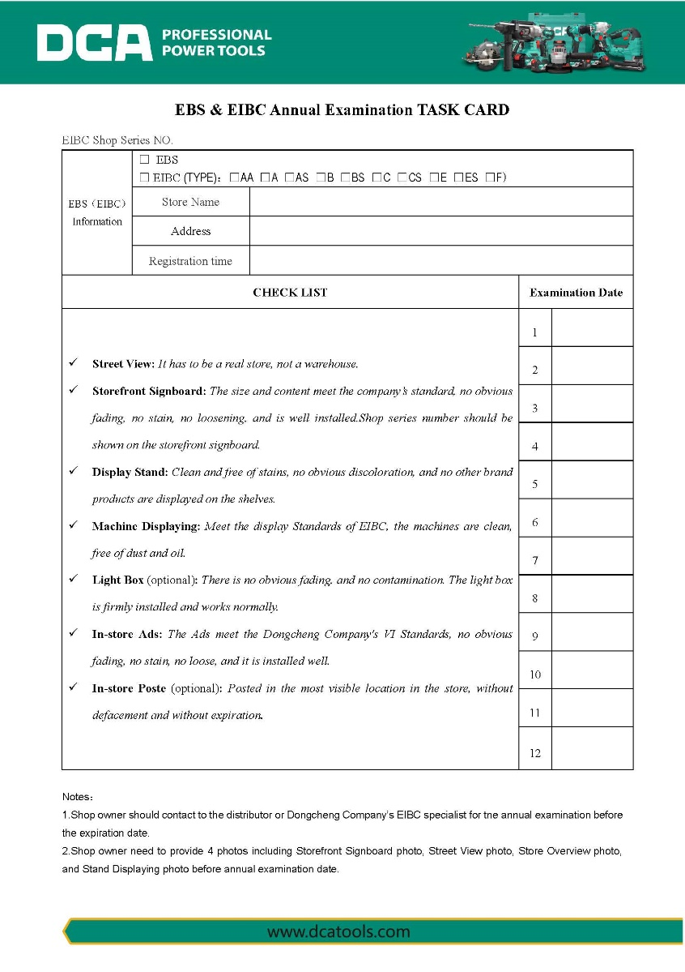
05-3
ANNUAL EXAMINATION FORMS - ANNUAL EXAMINATION TASK CARD
(reserve it for your own use)
Notes:see the attachment for detail

Slide 34



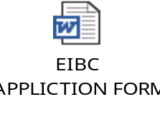



ATTACHMENT
Submission Time | Application | Application & Annual Examination | Reserve It For Your Own Use | Application & Annual Examination

Slide 35

NOTES – abbreviation exposition
EBS : Exclusive Brand Store
EIBC : Exclusive In-store Brand Corner
FOC : Free of Charge

Slide 36


